Slide 1



LinkedIn strategy –
1 post every week

Slide 2
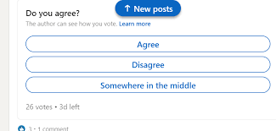
Polls
Polls are really necessary like in every post there must be some questions with valid and interesting options related to the topic described in the video.
Post – once a week

Slide 3
Posting on the golden hours: -
As per the analysis majority of the people on LinkedIn are working or students. So, they are busy with their work or maybe studying in college from 8 am to 7 pm. So accordingly, the golden hours are from 9 to 11 pm or on Sundays.

Slide 4
Viewpoint of the people: -
As we are dealing with social events or social issues, we can ask for people's viewpoints at the last. For example: - what are your opinions on this?

Slide 5
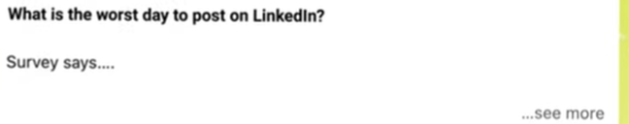
Hooking the people
We all know that the first impression is very important. so, we can attract a user via the following method in the picture. Where if a person sees our post, he/she will click on see more because of curiosity and will look at the whole post which will bring traffic to the post.

Slide 6
Precise and informative content… related to the topic….
People don’t like huge content so our posts should be precise, short, and informative which can make people attract.

Slide 7
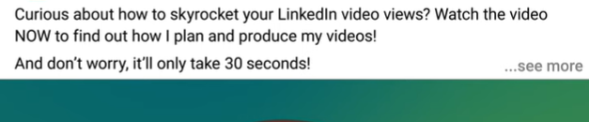
Top line or the headline –
It should be attractive to attract people read the remaining content in the post.
Call of action for the video and the length of the video
For example, Watch the Video NOW and find what’s inside. Don’t worry it is just 60 – 120 sec videos.

Slide 8
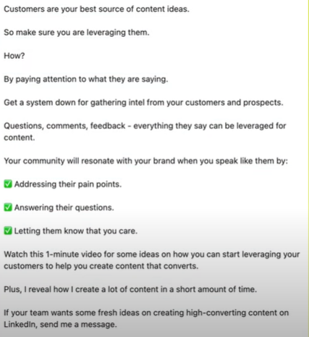
Under the see more - Our content should be spaced with bullets.
As given in the picture below- as it is easy to read and precise.
Put an attractive quote from a famous individual related to the topic to give a glimpse to the reader.

Slide 9
Use max to max 3-4 hashtags at the end. Don't use hashtags like "follow," "comment," or "like.“
Tag people on the post who are related to that specific post.
Between the post the maximum duration should be more than 6 hours
Don’t Just post and forget. You need to come back to the post and interact with any comments.

Slide 10
Video
3 sec to 10 min
Recommended for 1 or max 2 min unless it will be boring.
2. File size – 75kb to 1 gb
3. Any format – mp3, mp4 anything will be suitable
4. Aspect ratio –
Recommended aspect ratio of the video for square video can be 1 by 1 and for rectangular video it can be 16 by 9
5. Captions are important
Provide the captions as some individuals don’t turn on their speaker
6. Headline on the video
If relevant then only.
Using this algorithm to define the strategy for the LinkedIn post.

Slide 11
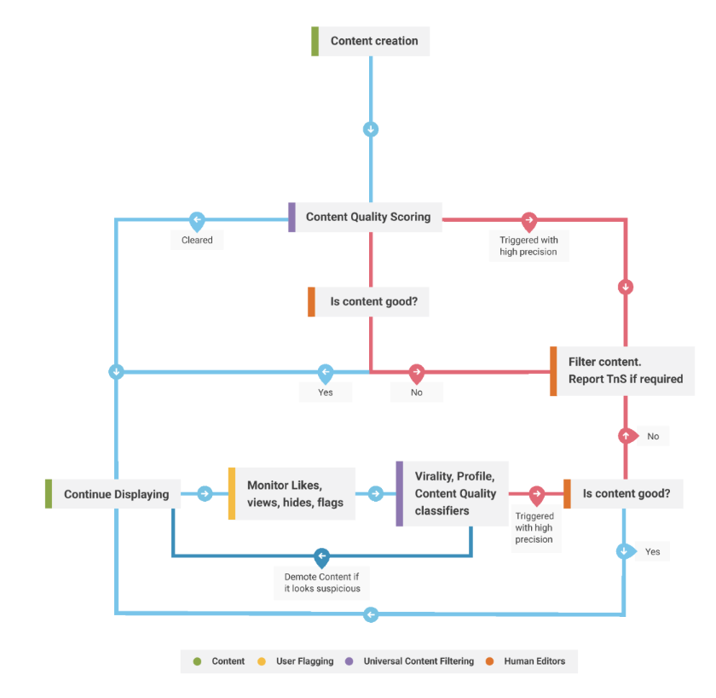
LinkedIn algorithm

Slide 12
ideal post:-
Above the see more :-
starting with a headline or a quote from a famous person which is related to the topic.
call of action for the video and the length
video
under see more
content
Precise
Informative
Good grammar
Use bullets and spaces so that reader can easily understand the content.
Taking the opinions of the audience.
Hashtags and tagging the people.
Polls once in 3-4 days.

Slide 13
Youtube –
1 video every month

Slide 14
YouTube
Video formation and editing
Canva – it is a graphic design platform, used to create social media graphics, presentations, posters, documents and other visual content. The app includes templates for users to use.
https://www.youtube.com/watch?v=AlrC-XaKwew
https://www.youtube.com/watch?v=0dqhpLRPkRY

Slide 15
2. Voice editing – using audacity
Audacity is a free and open-source digital audio editor and recording application software, available for Windows, macOS, Linux, and other Unix-like operating systems.
https://www.youtube.com/watch?v=MmTcvO_7M5U

Slide 16
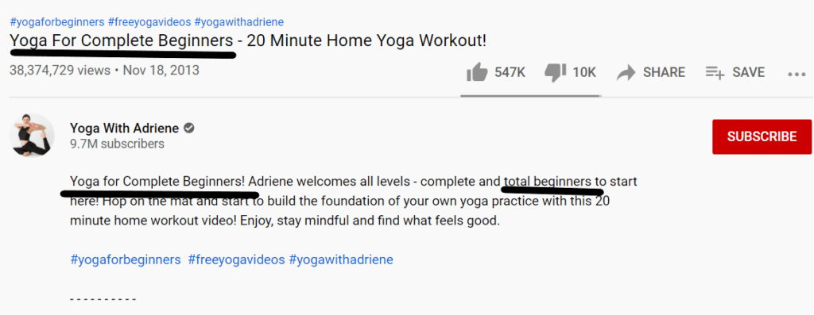
3. Description writing
A YouTube video description is the text below each of your videos. Viewers can read YouTube video descriptions by clicking on the 'See more' button below the video. These video descriptions usually include: A short explanation of what the video is about, including relevant keywords.
https://www.youtube.com/watch?v=aS4slsNv89A
https://www.youtube.com/watch?v=_GoCUmRGxVk

Slide 17
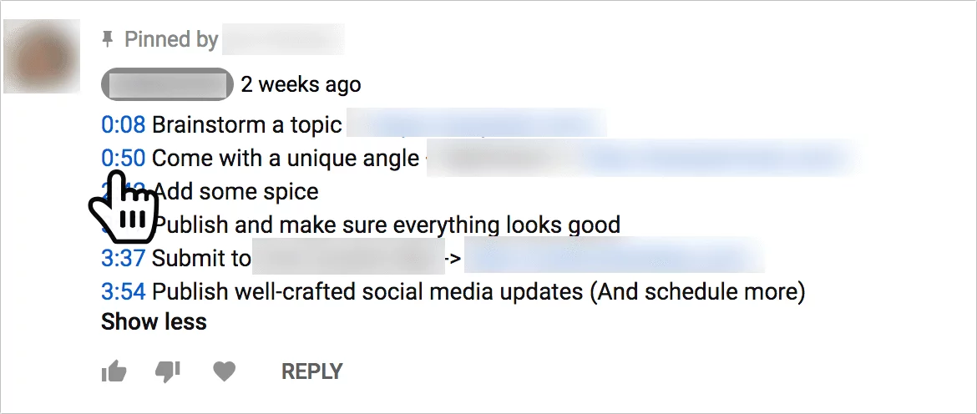
4. Time stamp
A YouTube timestamp is a way to link to a specific moment in your video. Often, users will bounce or navigate away from video content if it is not what they are looking for.
https://www.youtube.com/watch?v=yfEdhlBuxCU

Slide 18
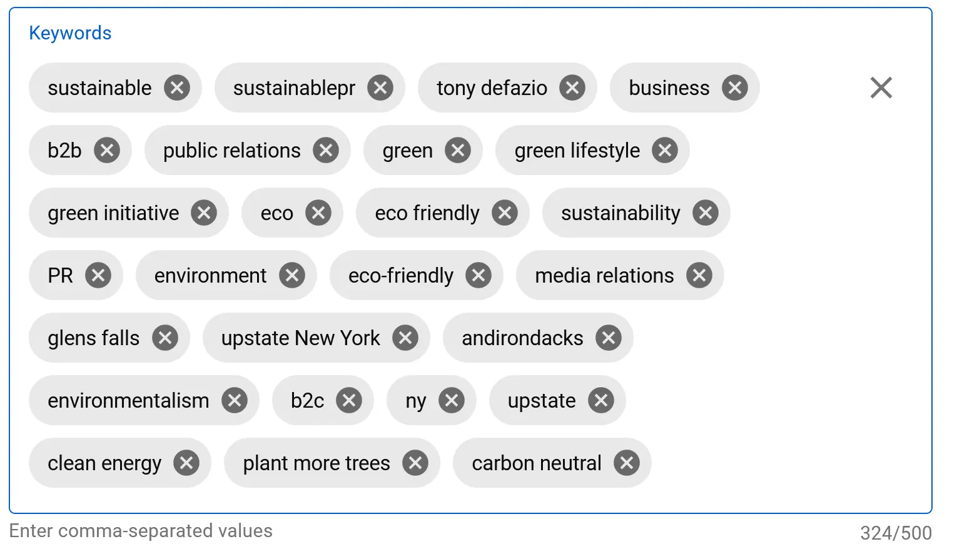
5. Keyword writing
YouTube keyword tags are hidden phrases that YouTube enables you to attach to your videos to help the platform understand what your video is about.
https://www.youtube.com/watch?v=V-ZRl1ny3Gg
https://www.youtube.com/watch?v=jLU7m3N9gQc

Slide 19
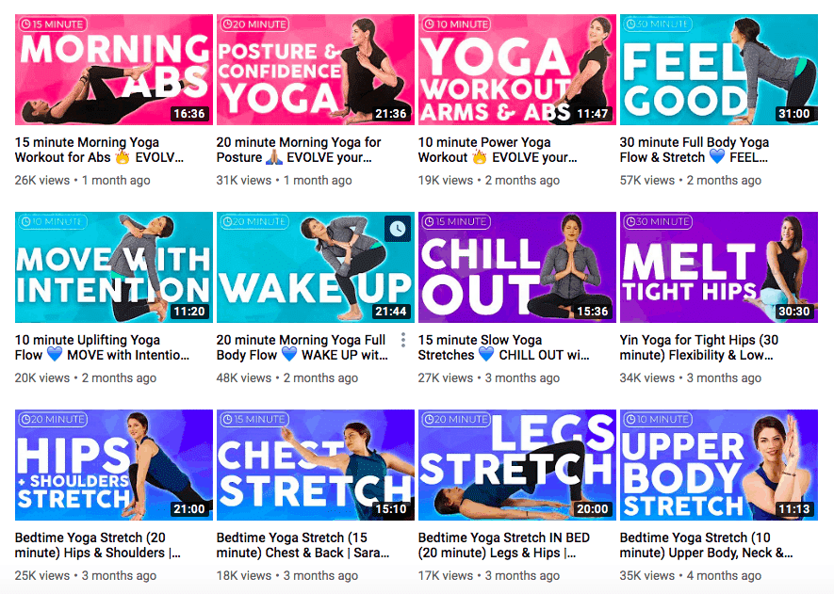
6. Thumbnail making
Video thumbnails let your audience view a quick snapshot of your video. You can choose from the options YouTube automatically generates, or upload your own if your account is verified.
https://www.youtube.com/watch?v=FAvS3e2PBKE

